Slide 1
Title card for an exceedingly short presentation (With 9 slides) (Like a cat)
By Froggy Fresh

Slide 2
Interface
An interface defines a set of methods and properties that a class must implement
An interface cannot be instantiated, you can only implement it in other classes

Slide 3
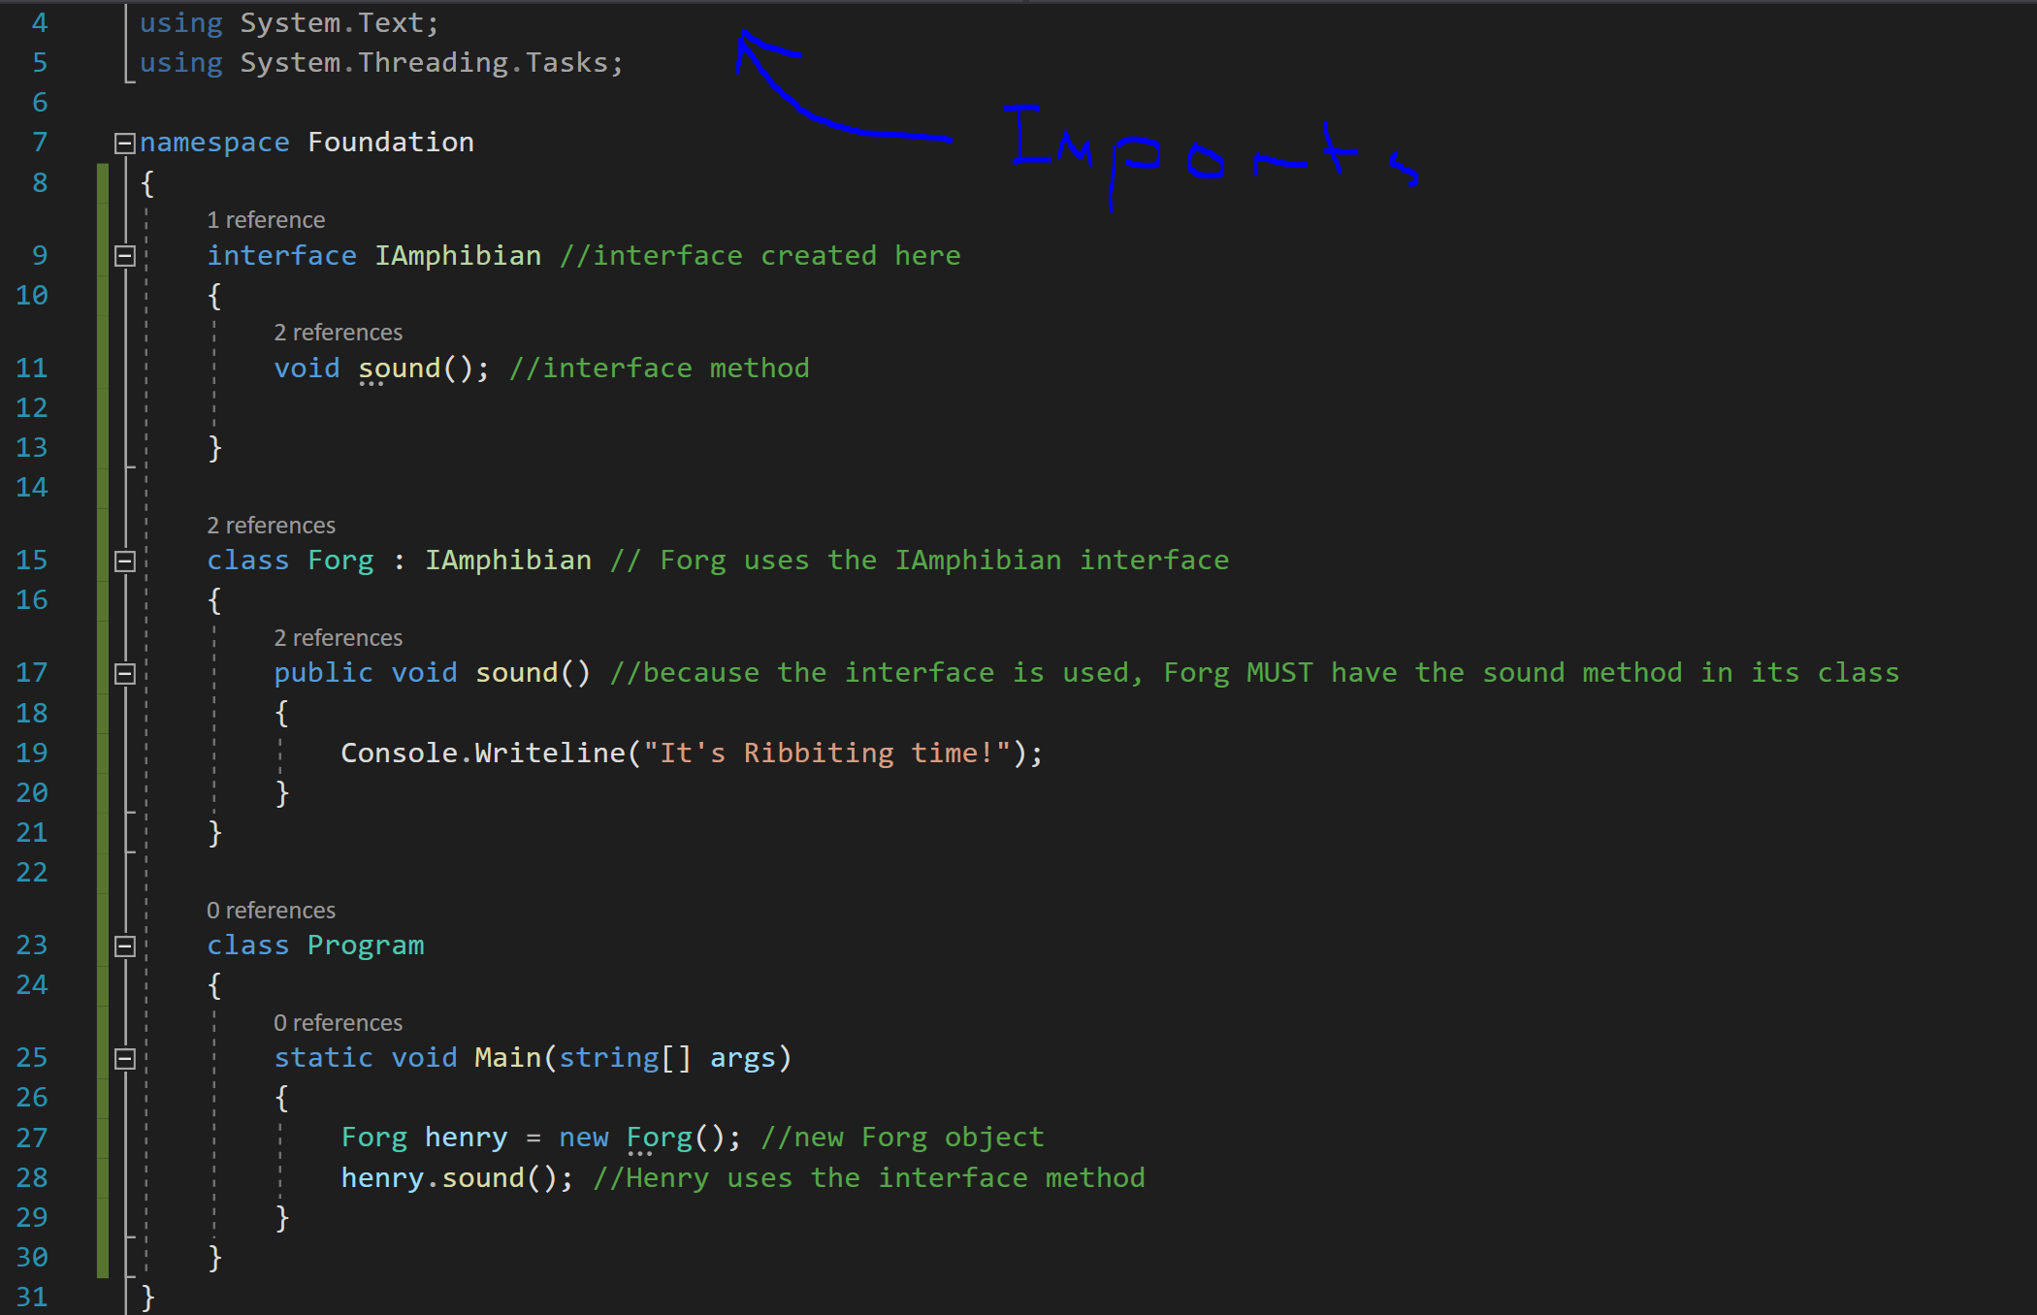

Slide 4
Abstract Classes
An abstract class is a class that cannot be instantiated
It defines another class kinda like a blueprint or template
An abstract class can have abstract and regular methods
Abstract methods must be implemented by the class that inherits the abstract class

Slide 5
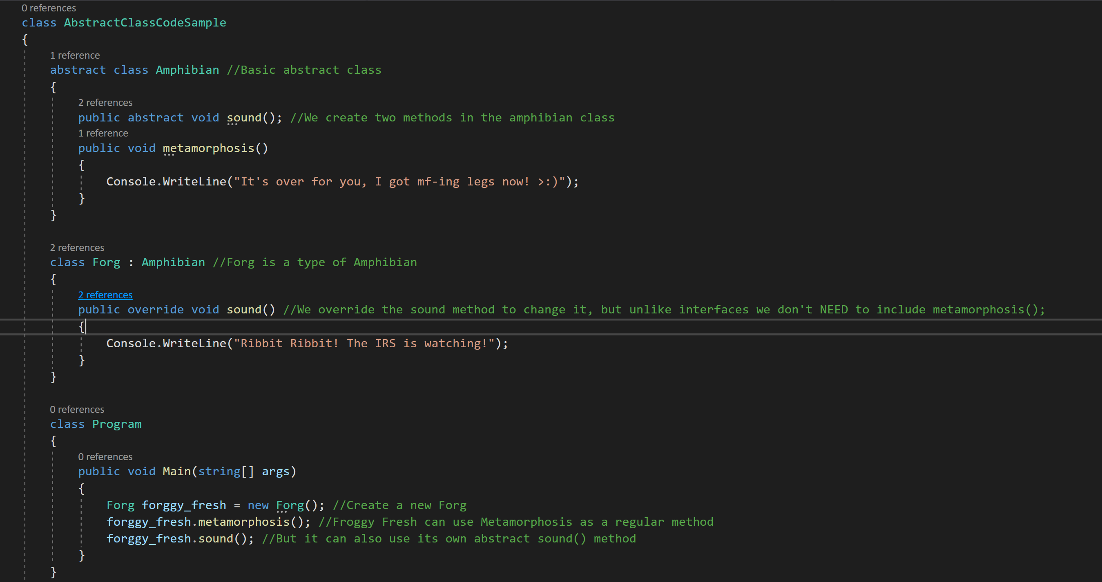

Slide 6
Virtual Methods
A virtual method is a method that can be overridden by a derived class
This is useful when a child class function needs to do something different/more specific than the parent class function
If the child class doesn’t override the virtual function it will inherit the function as written in the parent class

Slide 7
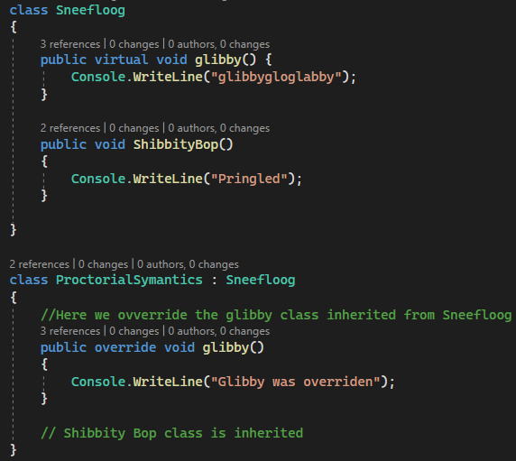
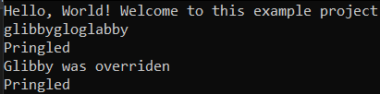
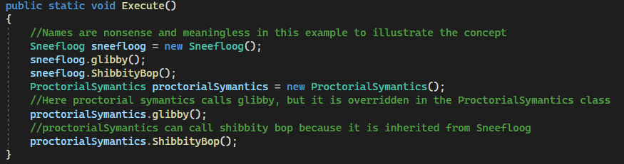

Slide 8
Polymorphism
Polymorphism allows a derived class to be treated as an instance of its base class
This is achieved using virtual methods, interfaces and abstract classes

Slide 9
